Slide 2
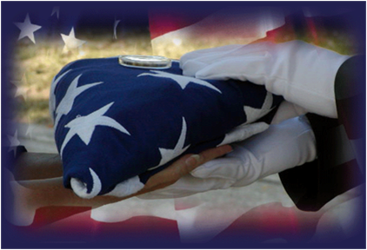
Why should you care?
In 2019:
35 Sailors and Marines lost their lives
Impact: 35 trained and ready Sailors and Marines are no longer with us.
Notes:
Not to start off on such a somber note but the facts are real. These 35 Sailors and Marines all died between Labor Day 2019 and New Year’s Day 2020. These shipmates were all sitting through their Fall/Winter safety presentations last year- how many knew their fates? So listen up, this is real, as real as it gets.

Slide 3
Notes:
These are Calendar Years 2015-2019 (5 Year totals)

Slide 4
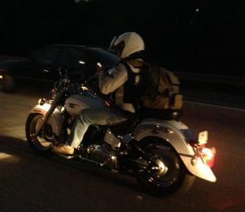
Department of the Navy
Traffic and Off-Duty/Recreation Mishaps
CY 15-19
Total Traffic and Off-Duty/Recreation Fatalities
CY19 was 7% lower than previous 5-year average (56 vs. 60.4).
CY19 was 7% lower than previous year (56 vs. 60).
Automobile Fatalities
CY19 was 9% higher than 5-year average (30 vs 27.6).
CY19 was 7% higher than previous year (30 vs. 28).
Motorcycle Fatalities
CY19 was 29% lower than 5-year average (20 vs 28.2).
CY19 was 31% lower than previous year (20 vs. 29).
Pedestrian Fatalities
CY19 was 30% higher than 5-year average (6 vs. 4.6).
CY19 was 100% higher than previous year (6 vs. 3).
Off-Duty/Recreation Fatalities
CY19 was 30% lower than 5-year average (10 vs 14.2).
CY19 was 29% lower than previous year (10 vs. 14).
Notes:
So how does this breakdown? Are we doing better? Worse?
The Naval Safety Center welcomes and appreciates any fleet feedback or informal analysis with regards to fleet trends, data, and causal factors.
What could be driving these numbers? What can we do as a service to improve?
These stats are from the full five Calendar Years 2015-2019

Slide 5
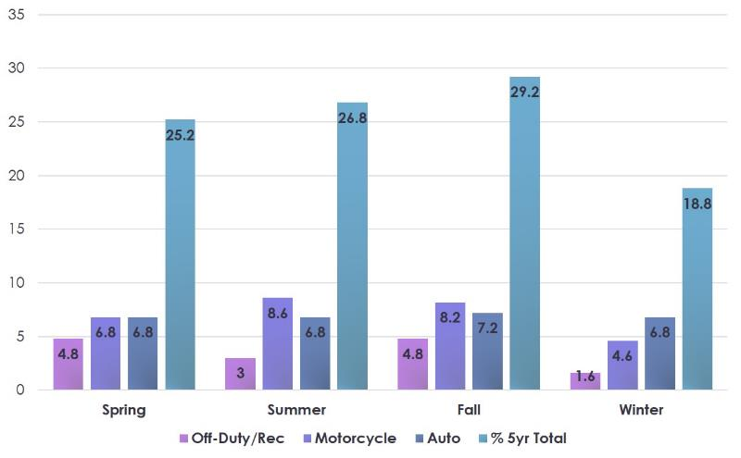
Average Department of the Navy
Off-Duty Recreational Fatalities CY15-19
Notes:
So how does this breakdown? Are we doing better? Worse?
The Naval Safety Center welcomes and appreciates any fleet feedback or informal analysis with regards to fleet trends, data, and causal factors.
What could be driving these numbers? What can we do as a service to improve?
These stats are from the full five Calendar Years 2015-2019

Slide 6
Distracted Driving
Distracted driving is any activity that diverts attention from driving, including talking or texting on your phone, eating and drinking, talking to people in your vehicle, fiddling with the stereo, entertainment or navigation system—anything that takes your attention away from the task of safe driving.
According to the National Highway Transportation Safety Association (NHTSA), texting is the most alarming distraction. Sending or reading a text is just one activity that takes your eyes off the road for 5 seconds. At 55 mph, that's like driving the length of an entire football field with your eyes closed.
You cannot drive safely unless the task of driving has your full attention. Any non-driving activity you engage in is a potential distraction and increases your risk of crashing.
Notes:
To prevent tragedies due to distracted driving, motorists are urged to:
•Turn off electronic devices and put them out of reach before starting to drive.
•Be good role models for young drivers and set a good example. Talk with your teens about responsible driving.
•Speak up when you are a passenger and your driver uses an electronic device while driving. Offer to make the call for the driver, so his or her full attention stays on the driving task.
•Always wear your seat belt. Seat belts are the best defense against unsafe drivers.
Handheld Cellphone Use: 22 states, D.C., Puerto Rico, Guam and the U.S. Virgin Islands prohibit all drivers from using handheld cellphones while driving. All are primary enforcement laws — an officer may cite a driver for using a handheld cellphone without any other traffic offense taking place.
All Cellphone Use: No state bans all cellphone use for all drivers, but 37 states and D.C. ban all cellphone use by novice drivers, and 23 states and D.C. prohibit it for school bus drivers.
Text Messaging: Washington was the first state to pass a texting ban in 2007. Currently, 48 states, D.C., Puerto Rico, Guam and the U.S. Virgin Islands ban text messaging for all drivers. All but three have primary enforcement. Of the two states without an all-driver texting ban, one prohibits text messaging by novice drivers.
Sources: https://www.nhtsa.gov/risky-driving/distracted-driving
https://www.ghsa.org/index.php/state-laws/issues/distracted%20driving

Slide 7
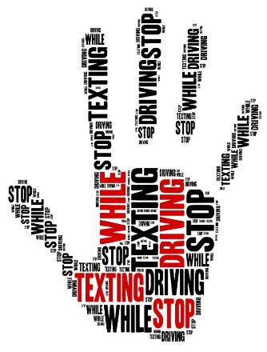
Distracted Driving (cont.)
According to NHTSA data*, 2,841 people were killed in 2018 in the U.S.
400,000 were injured in motor vehicle crashes involving distracted drivers in 2018 in the U.S.
Eight percent of fatal crashes, 15 percent of injury crashes, and 14 percent of all police-reported motor vehicle traffic crashes in 2018 were reported as distraction-affected crashes.
*Most current data available
Notes:
Eight percent of fatal crashes, 15 percent of injury crashes,
and 14 percent of all police-reported motor vehicle traffic
crashes in 2018 were reported as distraction-affected
crashes.
■ In 2018 there were 2,841 people killed and an estimated
additional 400,000 people injured in motor vehicle crashes
involving distracted drivers.
■ Five percent of all drivers involved in fatal crashes were
reported as distracted at the time of the crashes. Eight percent
of drivers 15 to 19 years old involved in fatal crashes
were reported as distracted. This age group has the largest
proportion of drivers who were distracted at the time of the
fatal crashes.
■ In 2018 there were 506 nonoccupants (pedestrians, pedalcyclists,
and others) killed in distraction-affected crashes.
Sources: https://crashstats.nhtsa.dot.gov/Api/Public/ViewPublication/812926

Slide 8
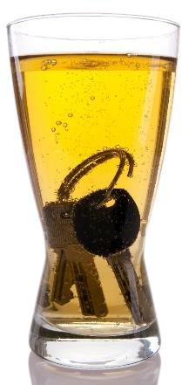
Never Drink and Drive…Ever.
There are things a person can do if they have been drinking (or know they will be). These include:
Call a cab. Use a ride application.
If the destination is nearby, walk home.
Have a designated driver before drinking. Give them the keys before drinking.
Things that won't work to sober up:
Drinking coffee, taking a cold shower, eating, drinking lots of water, sweating… and so many more myths. TIME is the only way.
Notes:
No matter how much a person drinks, or how it appears they can "hold their liquor," no one should drive after drinking, because they put others at risk every time they settle into a car. If you don't drink and drive, you just might save a life.
Despite all the common myths for how to sober up, the only true one is TIME.

Slide 9
The Effects of Blood Alcohol Concentration
.02 Some loss of judgment; relaxation, slight body warmth, altered mood. A decline in visual functions (rapid tracking of a moving target), declining ability to perform two tasks at the same time
.05 Exaggerated behavior, may have a loss of small-muscle control (e.g., focusing your eyes), impaired judgment, heightened euphoria, lowered alertness, a loss of inhibition, reduced coordination, reduced ability to track moving objects, difficulty steering, reduced response to emergency driving situations
.08 Muscle coordination becomes poor (e.g., balance, speech, vision, reaction time, and hearing), harder to detect danger, judgment, self-control, reasoning, and memory are impaired, concentration, short-term memory loss, speed control, reduced information-processing capability (e.g., signal detection, visual search), and impaired perception
Notes:
Alcohol is a substance that reduces the function of the brain, impairing thinking, reasoning and muscle coordination. All these abilities are essential to operating a vehicle safely.
As alcohol levels rise in a person’s system, the negative effects on the central nervous system increase, too. Alcohol is absorbed directly through the walls of the stomach and small intestine. Then it passes into the bloodstream where it accumulates until it is metabolized by the liver. Alcohol level is measured by the weight of the alcohol in a certain volume of blood. This is called Blood Alcohol Concentration, or BAC. At a BAC of .08 grams of alcohol per deciliter (g/dL) of blood, crash risk increases exponentially. Because of this risk, it’s illegal in all 50 States, the District of Columbia and Puerto Rico to drive with a BAC of .08 or higher. However, even a small amount of alcohol can affect driving ability.
Despite the fact that it’s illegal to drive drunk, one person was killed every 50 minutes in a drunk driving crash on our nation’s roads in 2018. That's a total of 10,511 people who died in alcohol-impaired driving crashes in one year.
BAC is measured with a breathalyzer, a device that measures the amount of alcohol in a driver’s breath, or by a blood test.
https://www.nhtsa.gov/risky-driving/drunk-driving#resources

Slide 10
The Effects of Blood Alcohol Concentration (cont.)
.10 Clear deterioration of reaction time and control, slurred speech, poor coordination, and slowed thinking, reduced ability to maintain lane position and brake appropriately
.15 Far less muscle control than usual, vomiting may occur (unless this level is reached slowly or a person has developed a tolerance for alcohol), significant loss of balance. Substantial impairment in vehicle control, attention to driving task, and in necessary visual and auditory information processing
Notes:
Alcohol is a substance that reduces the function of the brain, impairing thinking, reasoning and muscle coordination. All these abilities are essential to operating a vehicle safely.
As alcohol levels rise in a person’s system, the negative effects on the central nervous system increase, too. Alcohol is absorbed directly through the walls of the stomach and small intestine. Then it passes into the bloodstream where it accumulates until it is metabolized by the liver. Alcohol level is measured by the weight of the alcohol in a certain volume of blood. This is called Blood Alcohol Concentration, or BAC. At a BAC of .08 grams of alcohol per deciliter (g/dL) of blood, crash risk increases exponentially. Because of this risk, it’s illegal in all 50 States, the District of Columbia and Puerto Rico to drive with a BAC of .08 or higher. However, even a small amount of alcohol can affect driving ability. Despite the fact that it’s illegal to drive drunk, one person was killed every 50 minutes in a drunk driving crash on our nation’s roads in 2018. That's a total of 10,511 people who died in alcohol-impaired driving crashes in one year.
BAC is measured with a breathalyzer, a device that measures the amount of alcohol in a driver’s breath, or by a blood test.
https://www.nhtsa.gov/risky-driving/drunk-driving#resources

Slide 11
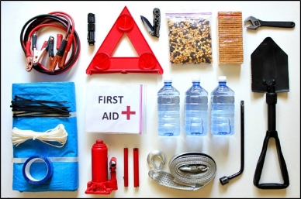
What Should You Keep in Your Vehicle?
A properly inflated spare tire, wheel wrench, and tripod jack
Jumper cables
Tool kit and a multipurpose utility tool
Flashlight and extra batteries
Reflective triangles and brightly colored cloth to make your vehicle more visible
First-aid kit with gauze, tape, bandages, antibiotic ointment, aspirin, non-latex gloves, scissors, hydrocortisone, thermometer, tweezers, and instant cold compress
Nonperishable, high-energy foods, such as unsalted nuts, dried fruits, and hard candy
Notes:
Every vehicle should have an emergency supply kit located in the trunk. Kits should be checked every six months, and expired items should be replaced to keep it up to date. It’s also a good idea to keep family and emergency phone numbers, including your auto insurance provider and a towing company, in your phone.

Slide 12
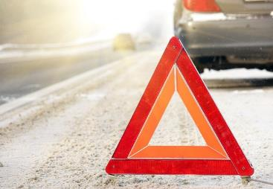
What Should You Keep in Your Vehicle? (cont.)
Reflective vest in case you need to walk to get help
Drinking water
Compass
Car charger for your cell phone
Fire extinguisher
Duct tape
Rain poncho
Additional items for cold weather include a snow brush, shovel, windshield washer fluid, warm clothing, cat litter for traction and blankets
Notes:
Every vehicle should have an emergency supply kit located in the trunk. Kits should be checked every six months, and expired items should be replaced to keep it up to date. It’s also a good idea to keep family and emergency phone numbers, including your auto insurance provider and a towing company, in your phone.

Slide 13
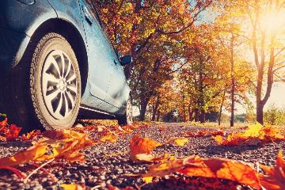
Drive Safely as it Gets Darker
Daylight Savings Time ends every year on the first Sunday in November. This time change means it starts getting dark earlier.
When you change your clocks, it’s also a great time to check the batteries in your smoke and carbon monoxide detectors.
With the time change, more people will find themselves driving in the dark.
Notes:
While we do only one quarter of our driving at night, 50% of traffic deaths happen at night. It doesn't matter whether the road is familiar or not, driving at night is always more dangerous.
Shorter days, fatigue, compromised night vision, rush hour and impaired drivers are some of the risks we face when driving at night. These risks become especially pronounced moving into the weekend, with fatal crashes peaking on Saturday nights, according to NSC analysis of NHTSA data.
https://www.nsc.org/road-safety/safety-topics/night-driving

Slide 14
Drive Safely as it Gets Darker
(cont.)
Depth perception, color recognition, and peripheral vision can be compromised in the dark, and the glare of headlights from an oncoming vehicle can temporarily blind a driver.
Even with high-beam headlights on, visibility is limited to about 500 feet (250 feet for standard headlights), creating less time to react to something in the road, especially when driving at higher speeds.
Notes:
When Daylight Saving Time ends many people will find themselves spending more time driving in the dark. Depth perception, color recognition and peripheral vision can be compromised in the dark, and the glare of headlights from an oncoming vehicle can temporarily blind a driver.
Even with high-beam headlights on, visibility is limited to about 500 feet (250 feet for normal headlights) creating less time to react to something in the road, especially when driving at higher speeds.
https://www.nsc.org/road-safety/safety-topics/night-driving

Slide 15
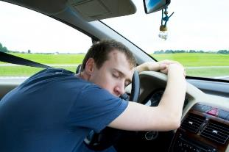
Fatigue is a KILLER
Drowsy driving puts everyone on the road at risk. Losing two hours of sleep has the same effect on driving as having three beers, and tired drivers are three times more likely to be in a car crash if they are fatigued. The National Sleep Foundation offers this advice:
•Get seven or more hours of sleep a night
•Don't drive if you've been awake for 16 hours or more
•Stop every two hours to rest
•Pull over and take a nap if you're drowsy
•Travel during times you are typically awake
Notes:
A National Sleep Foundation poll says 60% of adults have driven while they were tired, and another 37%, or 103 million people, have fallen asleep at the wheel. Of those, 13% say they fall asleep while driving at least once a month, and 4% say they have caused a crash by falling asleep while driving. The reasons are many – shift work, lack of quality sleep, long work hours, sleep disorders – and it doesn't only happen on lengthy trips.
These staggering numbers are backed up by a report by NHTSA that 100,000 police-reported crashes are a result of driver fatigue. Most crashes or near-misses happen at the times you would expect drivers to be tired: 4 to 6 a.m., midnight to 2 a.m. and 2 to 4 p.m., according to NSF.
Sleepiness or fatigue causes the following:
•Impaired reaction time, judgment and vision
•Problems with information processing and short-term memory
•Decreased performance, vigilance and motivation
•Increased moodiness and aggressive behaviors
***Note: Drowsy Driving Prevention Week is Nov. 1-8, 2020. ***
https://www.nsc.org/road-safety/safety-topics/night-driving

Slide 16
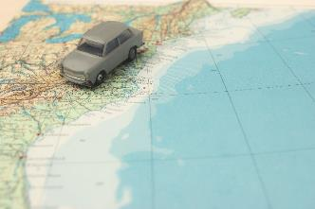
Road Trip Checklist
Start every trip well-rested.
Drive during daylight hours.
Schedule breaks every two hours.
Never drink and drive.
Pull over if you get tired.
Notes:
Tips for holiday travel:
* Ensure your vehicle is properly maintained. If maintenance is not up to date, have your car and tires inspected before you take a long drive.
* Map your route in advance and be prepared for busy roads during the most popular times of the year. If possible, consider leaving earlier or later to avoid heavy traffic.
* Keep anything of value in the trunk or covered storage area.
* If you’re traveling with children, remind them not to talk to strangers. Go with them on bathroom breaks and give them whistles to be used only if the family gets separated.
* Have roadside assistance contact information on hand, in case an incident occurs on the road.
* In case of an emergency, keep a cell phone and charger with you at all times. AAA and many other companies offer smartphone applications that enable motorists to request help without making a phone call.
Source:
https://exchange.aaa.com/safety/driving-advice/holiday-road-trip-travel-tips/#.X430f_0Ul7g

Slide 17
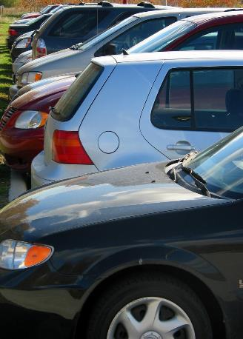
Parking Lot Safety
Auto insurers report the number of claims spike on Black Friday and run above normal through the holiday shopping season.
These spikes don’t include all the unreported fender benders.
Safety isn’t guaranteed just by driving slowly in parking lots.
You must always anticipate the actions of other drivers.
Notes:
NSC analysis of government data indicates that 9% of pedestrian deaths in parking lots result from backup incidents. Many vehicles today are equipped with backup cameras, which provide a wide view behind a vehicle operating in reverse, but that view may not be clear if the camera lens becomes obstructed.
Three safety reminders:
•It's best to conduct a quick, 360-degree walk-around before backing, keeping an eye out for low-lying objects
•Don't rely completely on technology; look over your shoulder and use your mirrors as you back up
•When parking, pull through on arrival whenever possible and if it works with the flow of traffic
Monitoring systems can alert drivers of vehicles in blind spots. Typically, drivers are warned of another vehicle's presence via symbol, sound or vibration. These systems may not detect motorcycles, smaller objects or people, however.
https://www.nsc.org/road-safety/safety-topics/distracted-driving/parking-lot-safety

Slide 18
Parking Lot Safety (cont.)
•Stay in lanes and avoid cutting across lots
•Drive slowly and use directional signals
•Obey stop signs and no-parking signs
•When backing out, be mindful of vehicles and pedestrians
•Watch for small children and parents with baby strollers
Inadequate pavement striping, potholes or cracks, lack of signage, debris, poor lighting, puddles, and snow and ice also can lead to pedestrian injuries. Slips, trips, and falls are common in parking lots, and falls, in general, are the leading cause of death for older adults.
Notes:
NSC analysis of government data indicates that 9% of pedestrian deaths in parking lots result from backup incidents. Many vehicles today are equipped with backup cameras, which provide a wide view behind a vehicle operating in reverse, but that view may not be clear if the camera lens becomes obstructed.
Three safety reminders:
•It's best to conduct a quick, 360-degree walk-around before backing, keeping an eye out for low-lying objects
•Don't rely completely on technology; look over your shoulder and use your mirrors as you back up
•When parking, pull through on arrival whenever possible and if it works with the flow of traffic
Monitoring systems can alert drivers of vehicles in blind spots. Typically, drivers are warned of another vehicle's presence via symbol, sound or vibration. These systems may not detect motorcycles, smaller objects or people, however.
https://www.nsc.org/road-safety/safety-topics/distracted-driving/parking-lot-safety

Slide 19
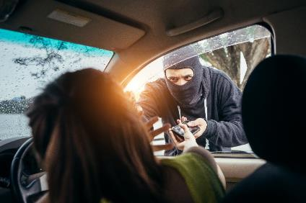
Parking Lot Safety (cont.)
Choosing the right parking spot can go a long way toward deterring theft and crime. Consumer Reports provides some simple safety rules:
•Pick spots that are well-lit and close to stores where you will be shopping
•Lock your doors
•Store purchases in places that are out of sight (in the trunk or tucked under dark-colored blankets
Notes:
Large parking lots, such as those found at shopping malls, are considered most vulnerable to crime, according to the Urban Institute Justice Policy Center. One way for consumers to steer clear of trouble is to pick a lot where pedestrian traffic is restricted and video surveillance equipment is used to monitor the facility.
https://www.nsc.org/road-safety/safety-topics/distracted-driving/parking-lot-safety

Slide 20
Carbon Monoxide Poisoning
Winter can be a prime time for carbon monoxide poisoning as people turn on their heating systems and warm their cars in garages. So as the weather turns colder, it's important to take extra precautions. Open the garage door prior to starting your vehicle in the garage.
Use caution when operating space heaters, wood stoves and gas logs. Ensure the space is well ventilated and clear.
TIP: Install a battery-operated or battery backup carbon monoxide detector in the hallway near each separate sleeping area in your home. Check or replace the battery when you change the time on your clocks each spring and fall and replace the detector every five years.
Notes:
Some additional tips include:
•Have your furnace, water heater and any other gas or coal-burning appliances serviced by a qualified technician every year
•Do not use portable flameless chemical heaters indoors
•Have your chimney checked and cleaned every year, and make sure your fireplace damper is open before lighting a fire and well after the fire is extinguished
•Never use a gas oven for heating your home
•Never use a generator inside your home, basement or garage or less than 20 feet from any window, door or vent; fatal levels of carbon monoxide can be produced in just minutes, even if doors and windows are open
•Never run a car in a garage that is attached to a house, even with the garage door open; always open the door to a detached garage to let in fresh air when you run a car inside
For more information visit the National Safety Council Carbon Monoxide Fact page https://www.nsc.org/home-safety/safety-topics/other-poisons/carbon-monoxide

Slide 21
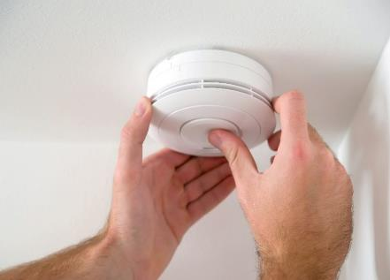
Carbon Monoxide Poisoning (cont.)
Carbon monoxide detectors save lives. Every year, over 400 people die in the U.S., and 50,000 are treated for carbon monoxide poisoning.
If alarm sounds move to fresh air and call 9-1-1.
The most common symptoms of carbon monoxide poisoning are often described as “flu-like”-headache, dizziness, weakness, upset stomach, vomiting, chest pain, and confusion.
Notes:
Carbon monoxide is an odorless, colorless gas that often goes undetected, striking victims caught off guard or in their sleep. This "invisible killer" is produced by burning fuel in cars or trucks, small engines, stoves, lanterns, grills, fireplaces, gas ranges, portable generators or furnaces. When the gas builds up in enclosed spaces, people or animals who breathe it can be poisoned. Ventilation does not guarantee safety.
For more information visit the National Safety Council Carbon Monoxide Fact page https://www.nsc.org/home-safety/safety-topics/other-poisons/carbon-monoxide

Slide 22
Food Safety for Holidays
•Wash your hands frequently when handling food.
•Keep raw meat away from fresh produce.
•Use separate cutting boards, plate, and utensils for uncooked and cooked meats to avoid cross-contamination.
•Use a food thermometer to ensure meat is cooked to a safe temperature.
•Refrigerate hot or cold leftover food within two hours of being served.
•When storing turkey, cut the leftovers in small pieces so they will chill quickly.
•Thanksgiving (or any other meal) leftovers are safe for three to four days when properly refrigerated.
Notes:
The foodsafety.gov website (https://www.foodsafety.gov/) from the U.S. Department of Health and Human Services provides some valuable holiday food safety tips.
Holiday Food Safety Video: https://www.youtube.com/watch?v=fH9ASI5zVEk&feature=youtu.be

Slide 23
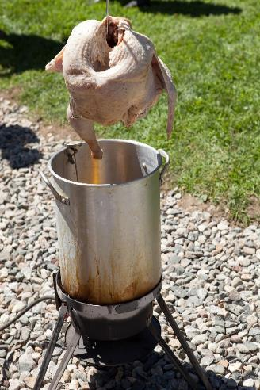
We can’t forget turkey fryers!
Did you know? Thanksgiving is the peak day for home cooking fires. Be alert to the dangers if you're thinking of celebrating the holidays by frying a turkey.
Deep fryer fires cause an average of five deaths, 60 injuries and more than $15 million in property damage each year, according to the National Fire Protection Association.
Notes:
For those who prefer fried turkey to seek out professional establishments or consider using an oil-less turkey fryer. If you must fry your own turkey, follow all U.S. Fire Administration turkey fryer guidelines.
https://www.usfa.fema.gov/downloads/pdf/publications/turkey_fryers_flyer.pdf
* Turkey fryers can easily tip over spilling hot oil across a large area. Use your turkey fryer only outdoors on a sturdy, level surface well away from things that can burn. Make sure to have a “3-foot kid- and pet-free zone” around your turkey fryer to protect against burn injuries.
* An overfilled cooking pot will cause oil to spill over when the turkey is placed inside. Determine the correct amount of oil needed by first placing the turkey in the pot with water.
* A partially frozen turkey will cause hot oil to splatter. Make sure your turkey is completely thawed before you fry it.
* Turkey fryers can easily overheat and start a fire. Check the temperature often with a cooking thermometer so the oil won’t overheat.
* The pot, lid and handles of a turkey fryer can get dangerously hot and cause burn injuries. Use long cooking gloves that protect hands and arms when you handle these items.

Slide 24
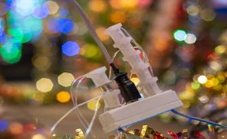
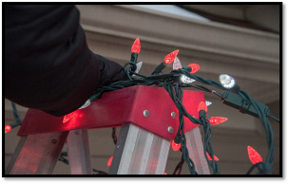
Holiday Decoration Safety
•Only use indoor lights indoors and outdoor lights outdoors, and choose the right ladder for the task when hanging lights
•Replace light sets that have broken or cracked sockets, frayed or bare wires, or loose connections
•Follow the package directions on the number of light sets that can be plugged into one socket
•Turn off all lights and decorations when you go to bed or leave the house
•Never nail, tack, or stress wiring when hanging lights and keep plugs off the ground away from puddles and snow
•Avoid placing breakable ornaments or ones with small, detachable parts on lower tree branches where small children can reach them
Notes:
Decorating is one of the best ways to get in a holiday mood, but emergency rooms see thousands of injuries involving holiday decorating every season.
https://www.nsc.org/home-safety/tools-resources/seasonal-safety/winter/holiday

Slide 25
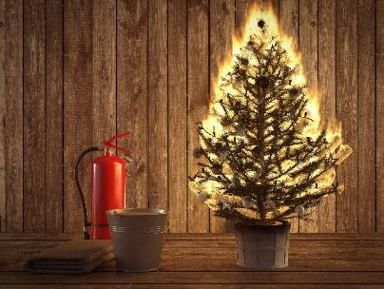
Holiday Decoration Safety (cont.)
•Keep potentially poisonous plants – mistletoe, holly berries, Jerusalem cherry (also known as Christmas or winter cherry), and amaryllis – away from children
•If using an artificial tree, check that it is labeled “fire resistant”
•If using a live tree, cut off about 2 inches of the trunk to expose fresh wood for better water absorption, remember to water it and remove it from your home when it is dry
•Place your tree at least 3 feet away from fireplaces, radiators and other heat sources, making sure not to block doorways
Notes:
Decorating is one of the best ways to get in a holiday mood, but emergency rooms see thousands of injuries involving holiday decorating every season.
https://www.nsc.org/home-safety/tools-resources/seasonal-safety/winter/holiday

Slide 26
Gift Safety
•Toys are age-rated for safety, not for children’s intellect and physical ability, so choose toys in the correct age range
•Choose toys for children under 3 that do not have small parts which could be choking hazards
•For children under 10, avoid toys that must be plugged into an electrical outlet
•Be cautious about toys that have button batteries or magnets, which can be harmful or fatal if swallowed
•When giving riding toys, give the gift of appropriate safety gear, too; helmets should be worn at all times and sized to fit
Notes:
Gifts and toys should inspire joy, not cause injuries. More than a quarter of a million children were seriously injured in toy-related incidents in 2017.
https://www.nsc.org/home-safety/tools-resources/seasonal-safety/winter/holiday
To find out about holiday toy safety and recalls, check the U.S. Consumer Product Safety Commission website. https://www.cpsc.gov/Recalls

Slide 27
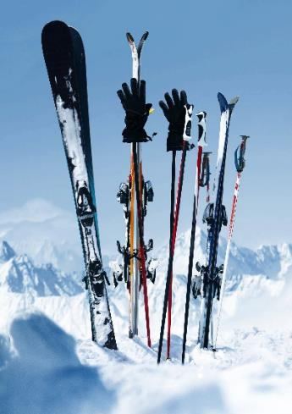
Winter Sports Safety
Skiers and snowboarders, no matter how experienced, should never ski alone. Nor should they ski off designated trails.
Almost 200,000 people were treated at hospitals, doctors' offices, and emergency rooms for injuries related to winter sports in 2018, according to the U.S. Consumer Product Safety Commission. This figure includes: 76,000 injuries from snow skiing. ... 22,000 injuries from sledding and tobogganing.
Notes:
https://orthoinfo.aaos.org/en/staying-healthy/winter-sports-injury-prevention/
Common winter sports injuries include sprains, strains, dislocations, and fractures. Many of these injuries happen at the end of the day, when people overexert themselves to finish that one last run before the day's end. Most winter sports injuries can easily be prevented if participants prepare for their sport by keeping in good physical condition, staying alert, and stopping when they are tired or in pain.

Slide 28
Winter Sports Safety (cont.)
•Get in shape for the season, and not just the week before a ski trip; a regular exercise routine will help reduce fatigue and injury
•Beginners should invest in proper instruction, including learning how to fall and get back up; experienced skiers/snowboarders should take a refresher course
•Always know the weather conditions before heading to the slopes; time of day can also affect visibility and make obstacles difficult to see
•Give skiers/snowboarders in front of you the right of way; they most likely can't see you
•If you have to stop, stop on the side of a run, not in the middle
Notes:
Additional tips include:
•Look both ways and uphill before crossing a trail, merging or starting down a hill
•Use skis with brakes or a snowboard with a leash to prevent runaway equipment
•Never ski on closed runs or out of boundaries because these areas are not monitored and there is no way to know what the snow conditions are; a rogue skier could even cause an avalanche
Drink plenty of water before, during and after activities
Avoid participating in sports when you are in pain or exhausted

Slide 29
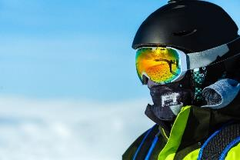
Winter Sports Safety (cont.)
Helmets reduce head injuries. However, even though helmet use has increased over the years, traumatic brain injuries still can occur with helmet use. Severe injury and death are prevented by avoiding risk-taking behaviors.
Skiers and snowboarders also should select quality equipment. Improperly fitted or ill-adjusted gear can cause injury, so it's best to ask for expert advice when purchasing and fitting boots, bindings, and skis/snowboards. While trendy ski/snowboard apparel may look good on the slopes, clothing should be functional. Wear bright colors, dress in layers, and make sure outerwear is made of fabric that is not only water repellent but slide-resistant.
Notes:
Additional tips include:
•Look both ways and uphill before crossing a trail, merging or starting down a hill
•Use skis with brakes or a snowboard with a leash to prevent runaway equipment
•Never ski on closed runs or out of boundaries because these areas are not monitored and there is no way to know what the snow conditions are; a rogue skier could even cause an avalanche

Slide 30
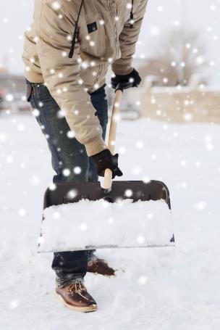
Snowmageddon: Snow Removal
Nationwide, snow shoveling is responsible for thousands of injuries and as many as 100 deaths each year.
It can put some people at risk of a heart attack. Sudden exertion, like moving hundreds of pounds of snow after being sedentary for several months, can put a significant strain on the heart.
Cold weather can increase heart rate and blood pressure. It can make blood clot more easily and constrict arteries, which decreases blood supply. This condition is true even in healthy people. Individuals over the age of 40 or who are relatively inactive should be particularly careful.

Slide 31
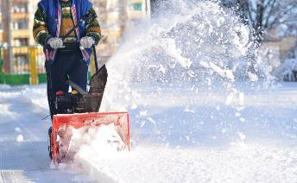
Snowmageddon: Snow Removal (cont.)
•Push the show rather than lifting it. If you do lift it, use a small shovel or only partially fill the shovel
•Lift with your legs, not your back
•Do not work to the point of exhaustion
•Know the signs of a heart attack, and stop immediately and call 9-1-1 if you're experiencing any of them; every minute counts
•Do not shovel after eating or while smoking
•Take it slow and stretch out before you begin
Notes:
And let’s not forget about snow blowers tips!
In addition to possible heart strain from pushing a heavy snow blower, be safe with tips from the American Academy of Orthopedic Surgeons, including:
•If the blower jams, turn it off
•Keep your hands away from the moving parts
•Be aware of the carbon monoxide risk of running a snow blower in an enclosed space
•Add fuel outdoors, before starting, and never add fuel when it is running
•Never leave it unattended when it is running

Slide 32
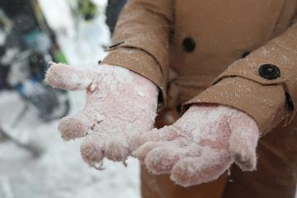
Brrrrrr… Watch for Frostbite!
Even skin that is protected can be subject to frostbite. It's the most common injury resulting from exposure to severe cold, and it usually occurs on fingers, toes, nose, ears, cheeks, and chin.
If caught early, it is possible to prevent permanent damage. If not, frostbite can cause tissue death and lead to amputation.
Notes:
If you suspect frostbite:
•Move the victim out of the cold and into a warm place
•Remove wet clothing and constricting items
•Protect between ﬁngers and toes with dry gauze
•Seek medical attention as soon as possible
•Warm the frostbitten area in lukewarm water (99 to 104 degrees) for 20 to 30 minutes only if medical care will be delayed and if there is no danger of the skin refreezing
•Do not use chemical warmers directly on frostbitten tissue
•Protect and elevate the frostbitten area

Slide 33
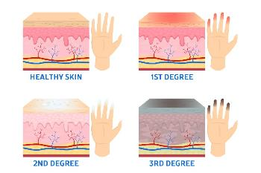
Frostbite (cont.)
Superficial frostbite affects the skin surface, while the underlying tissue remains soft. The skin appears white, waxy, or grayish-yellow and is cold and numb.
If the condition progresses to deep frostbite, all layers of the skin are affected and the outcome likely will be more serious. The skin will become completely numb and blisters may form, and eventually, the skin tissue dies and turns black.
Notes:
If you suspect frostbite:
•Move the victim out of the cold and into a warm place
•Remove wet clothing and constricting items
•Protect between ﬁngers and toes with dry gauze
•Seek medical attention as soon as possible
•Warm the frostbitten area in lukewarm water (99 to 104 degrees) for 20 to 30 minutes only if medical care will be delayed and if there is no danger of the skin refreezing
•Do not use chemical warmers directly on frostbitten tissue
•Protect and elevate the frostbitten area

Slide 34
Brrrrr…Hypothermia Too!
Hypothermia occurs when the body's core temperature drops below 95 degrees. Hypothermia is most associated with exposure to extreme cold, but it can also occur at higher temperatures if a person becomes chilled from being soaked with rain or submerged in water.
Severe shivering, one of the first signs of hypothermia, is beneficial in keeping the body warm. But as hypothermia progresses, shivering gives way to drowsiness or exhaustion, confusion, shallow breathing, irregular heartbeat, slurred speech, loss of coordination, and eventually, unconsciousness and death.
Notes:
If you encounter someone suffering from hypothermia:
•Check responsiveness and breathing, and call 911; except in mild cases, the victim needs immediate medical care
•Provide CPR if unresponsive and not breathing normally
•Quickly move the victim out of the cold
•Remove wet clothing.
•Warm the victim with blankets or warm clothing
•Only if the victim is far from medical care, use active rewarming by putting the victim near a heat source and putting warm (but not hot) water in containers against the skin
•Do not rub or massage the victim’s skin
•Be very gentle when handling the victim
•Give warm (not hot) drinks to an alert victim who can easily swallow, but do not give alcohol or caffeine
These steps are not a substitute for proper medical care. Be sure to seek medical attention for frostbite and hypothermia as soon as possible

Slide 35
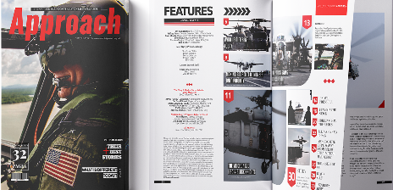
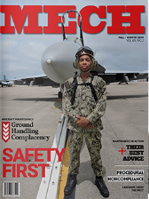
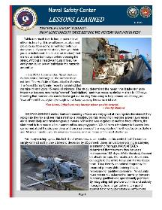
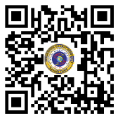
Naval Safety Center Resources
Want more? See our resources and publications!
Approach, MECH, and Special Edition magazines
RIDE, Surface Ship and Aviation Safety Newsletters
Lessons Learned products
And more available for download on our website!
Notes:
The Naval Safety Center (NAVSAFECEN) located in Norfolk, Va. provides resources and guidance to develop a Navy safety culture in which everyone is trained and motivated to manage risk, and to ensure combat readiness of our forces and the Navy’s global warfighting abilities.
Services provided include: policy, doctrine and guidance; safety surveys and assessment visits, training and education, multimedia products, marketing and outreach campaigns, and recognition and awards programs.
Our award-winning magazines current and archived can be found at https://safety.navylive.dodlive.mil

Slide 36
Questions?
Notes:
The Naval Safety Center (NAVSAFECEN) located in Norfolk, Va. provides resources and guidance to develop a Navy safety culture in which everyone is trained and motivated to manage risk, and to ensure combat readiness of our forces and the Navy’s global warfighting abilities.
Services provided include: policy, doctrine and guidance; safety surveys and assessment visits, training and education, multimedia products, marketing and outreach campaigns, and recognition and awards programs.
Our award-winning magazines current and archived can be found at https://safety.navylive.dodlive.mil

Slide 37
www.navalsafetycenter.navy.mil
Be sure to like and follow us on Facebook at https://www.facebook.com/NavalSafetyCenter
Notes:
You can find us at the following:
Website: www.navalsafetycenter.navy.mil
Facebook: https://www.facebook.com/NavalSafetyCenter
Instagram:
Twitter: https://twitter.com/NSC_Updates
Issuu: https://issuu.com/navalsafetycenter.com/stacks

